Slide 1
Twitter Sentiment & Stock Price Correlation
Presented by: The Four Forecasters
Georgetown University Data Science
Fall 2015 Cohort
Max Almodovar
Jonathan Creem
Andrew Miller
Caroline Morris

Slide 2
To Better Illustrate the Problem…
https://www.youtube.com/watch?v=4GA8MQGvr_U
https://www.youtube.com/watch?v=UOYi4NzxlhE

Slide 3

The Real Issue
Rise of big data presents the opportunity to incorporate analytics into forecasting models
THE STRUGGLE IS REAL for forecasters to accurately predict the stock market using Big Data. Its new, and many, just don’t know how.
Our model can help….!

Slide 4
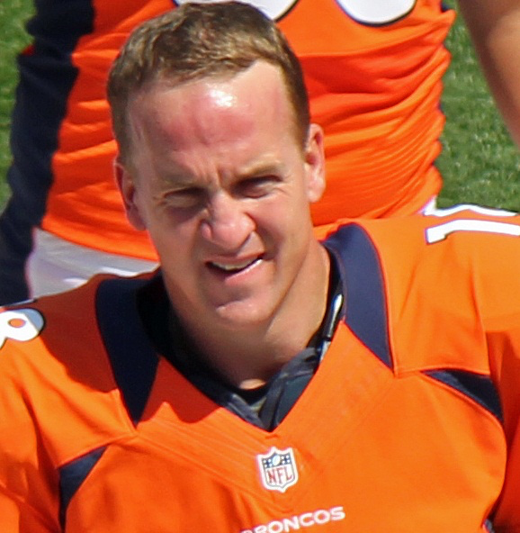
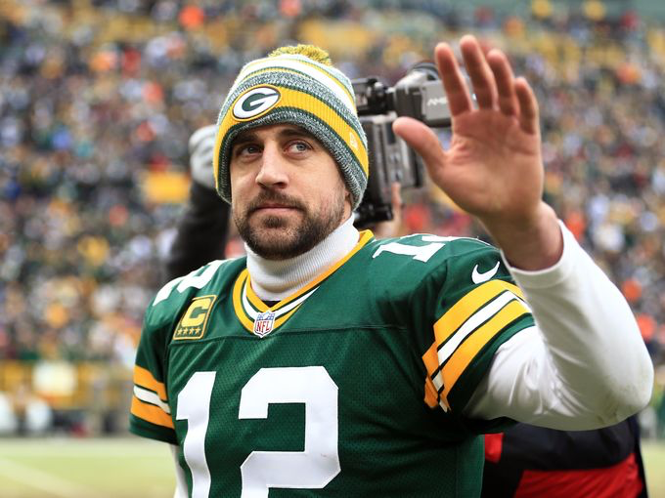
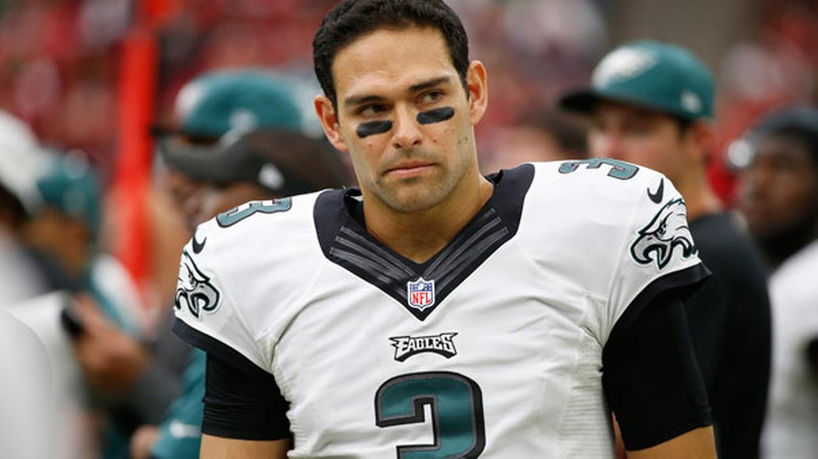
Our Hypotheses…We had two! (One came later...)
Twitter sentiment of auto-manufacturers is correlated with stock price fluctuation.
As more data is ingested, the accuracy of both our twitter sentiment model and our regression model will improve.
To put this in NFL terms… instead of ... (this season) or better yet (over time)..

Slide 5

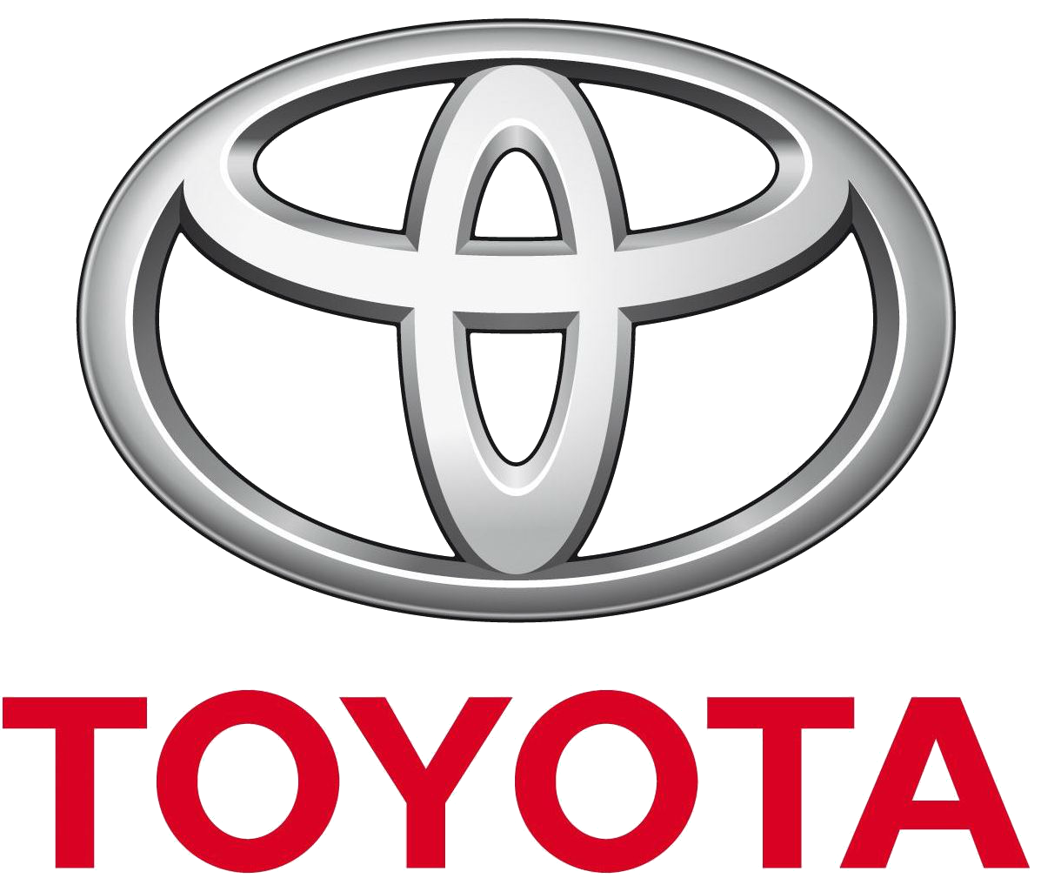





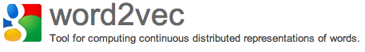


Data Science Pipeline - Tools
Data Ingestion
Data Munging
& Wrangling
Computation
and Analyses
Reporting
& Visualization
Modeling
& Application

Slide 6


Ingestion Module
Tweepy
Pymongo
NLTK
Data Wrangling Module
Regression Visualization
MatPlot Lib
Univariate Regressions
Twitter Sentiment Analysis.py
Twitter Sentiment Analysis

Slide 7

Sentiment Analysis (+1, -1)
Sentiment Visualization
Sentiment
Scores
Model (Multi-Variate Regression)
Model (Regression)
Model (Regression)
Fiat Stock Price
Results Visualization
Results Visualization
Results Visualization

Slide 8
Twitter Sentiment Analysis

Slide 9
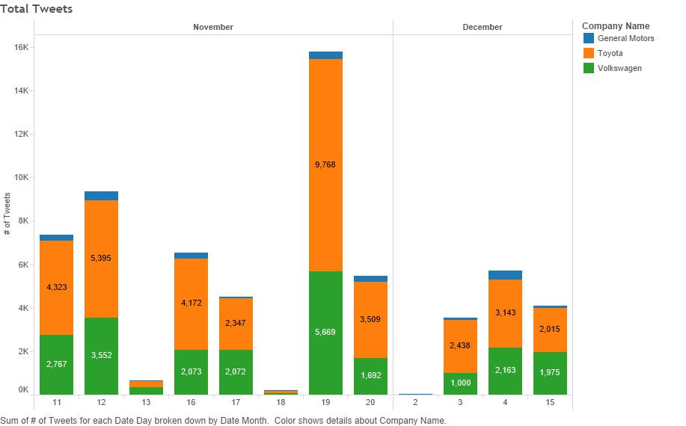
Tweets per Day

Slide 10
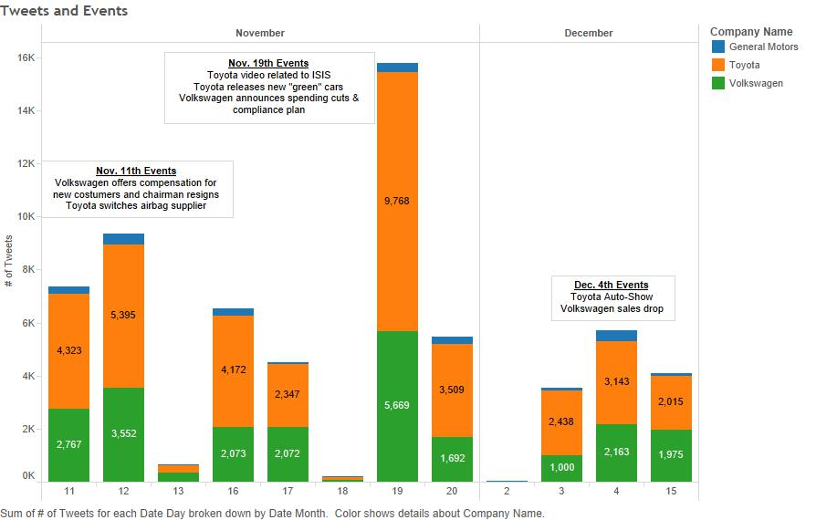
Events affecting sentiment

Slide 11
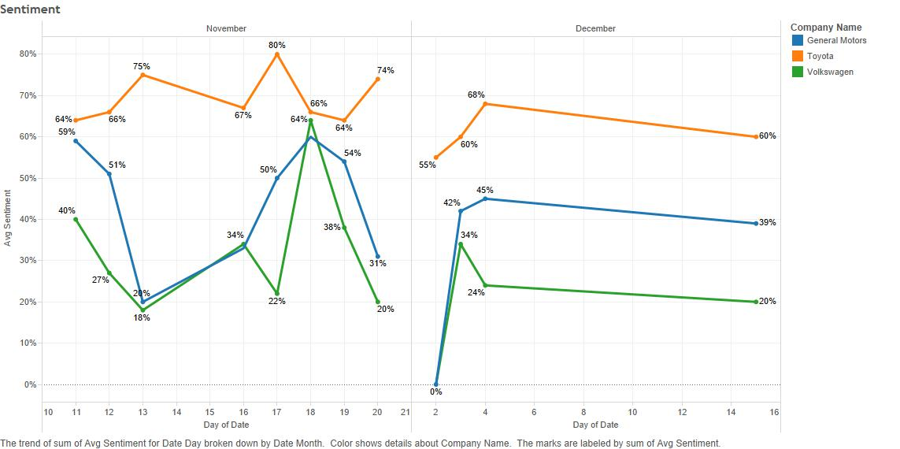
Twitter Sentiment by Day

Slide 12


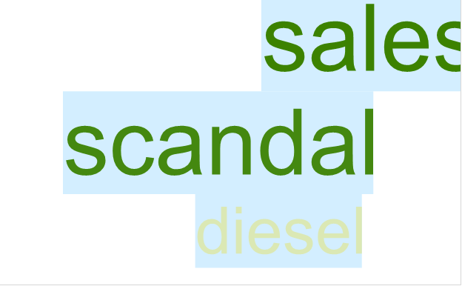
Most popular words on tweet-heavy days
Toyota, November 19
GM, November 12
Volkswagen, Dec 4

Slide 13
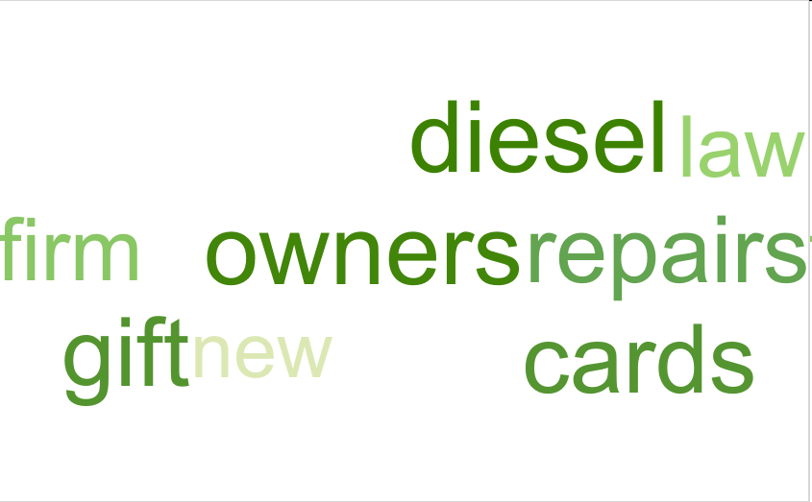

Good Days, Bad Days
Nov 18
Highest Sentiment Score
Dec 15
Lowest Sentiment Score

Slide 14
Word2Vec Word Associations
Some of the words from the previous slide, with word vectors that Word2Vec considers related.
Law: [(history, 0.5390466), (spanish, 0.5021017), (bible, 0.4971169)]
Chinese: [(thai, 0.5960268), (yummy, 0.5862064), (food, 0.5802457)]
Terrorists: [(delivers, 0.6527901), (#liesgirlstell, 0.6494534), (abortion, 0.6427389), (brutality, 0.6450986)]
Sues: [(emissions, 0.8482231), (scandal, 0.8285488), (whistleblower, 0.7530708), (volkswagen, 0.8451427)]
Repairs: [(brakes, 0.6788374), (mot, 0.6754294), (components, 0.6592078), (payments, 0.6592078)]

Slide 15
Regression Analysis

Slide 16
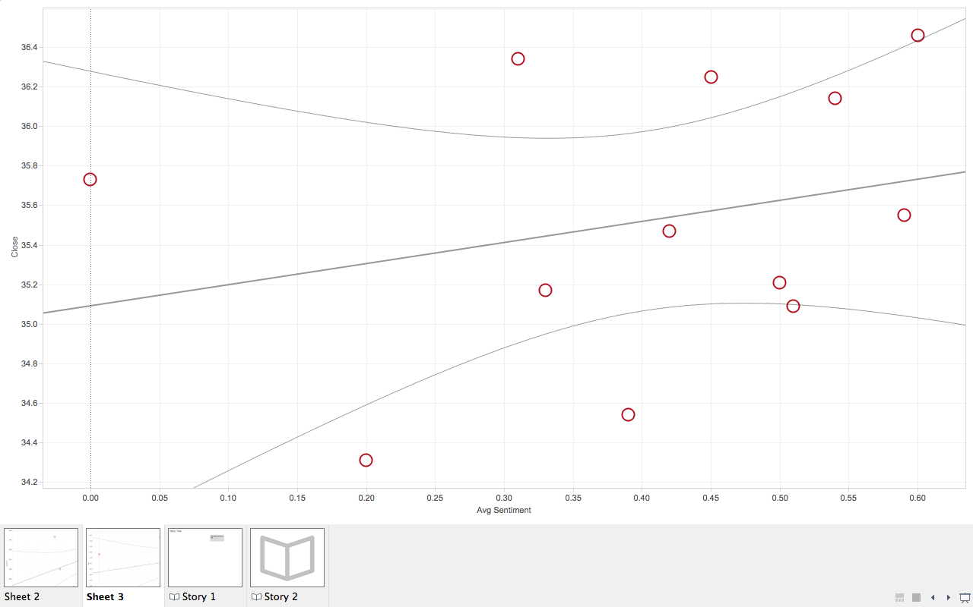
General Motors
Close Price ($)
Average Twitter Sentiment

Slide 17
Results
All else equal:
1% increase in Average Twitter Sentiment will increase the company's Stock Price by 1.23%
1% increase in Total Retweets will increase the company's Stock Price by 0.085%

Slide 18
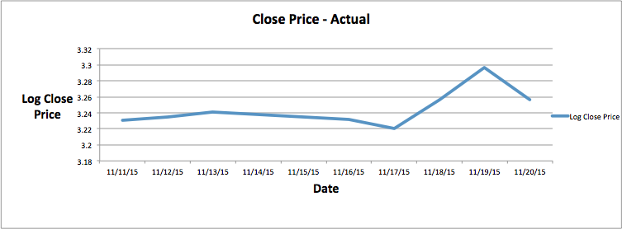
Sentiment Model vs Random Walk
Volkswagen

Slide 19
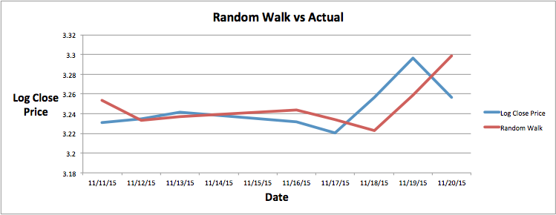
Sentiment Model vs Random Walk
Volkswagen

Slide 20
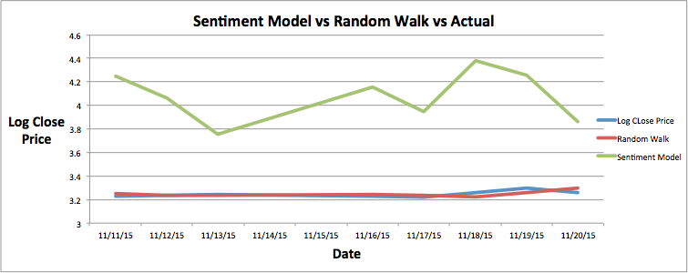
Sentiment Model vs Random Walk
Volkswagen

Slide 21
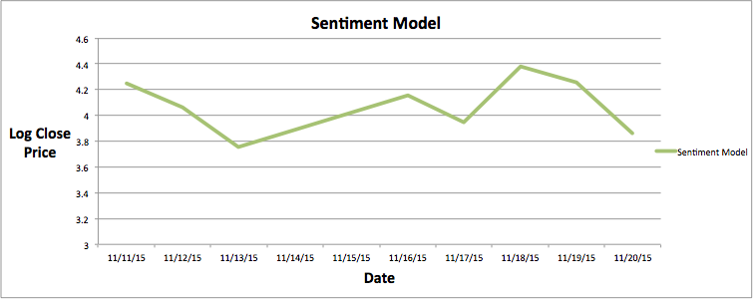
Sentiment Model vs Random Walk
Volkswagen

Slide 22
Sentiment Model vs Random Walk
Volkswagen

Slide 23
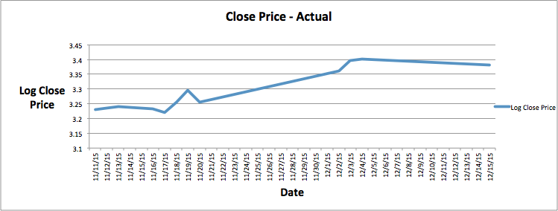
Sentiment Model vs Random Walk
Volkswagen

Slide 24
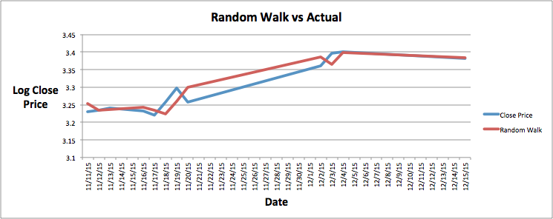
Sentiment Model vs Random Walk
Volkswagen

Slide 25
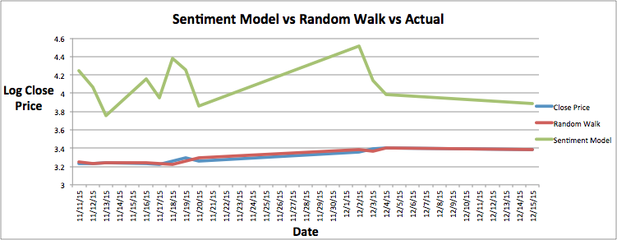
Sentiment Model vs Random Walk
Volkswagen

Slide 26
Accuracy Measures

Slide 27
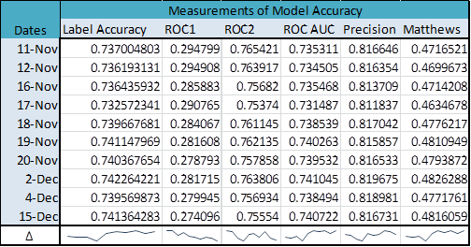
Increase in Accuracy of Twitter Model
Improvement in accuracy for all metrics
True positives significantly outnumber false positives; the model classification is superior to random classification
Matthews correlation coefficient is measured on a scale of -1 to 1, with 0 indicating random prediction and 1 being positive prediction
Note: the precision curve, which measures ability to avoid false positives, shows a decrease on the last day compared to improvements in the other metrics. Taken alongside the decreasing ROC2 (true positive) score, this suggests a possible issue with sentiment classification for terms used or introduced in December.

Slide 28
What we Learned!
Text Mining is HARD!
Twitter has limits to the amount of historical data that can be obtained on Twitter for free.
It is possible to find no correlation between the two at all – in that case, the model needs to be adjusted.
Looking at additional big data, like Google trends and Google search, might provide additional insight into behaviors of stock market.

